Slide 1
CSE 4705: Project Summary
Tom McCarthy & Filip Graham

Slide 2

The Mission
Explore relationships and trends in real estate data and other metrics
What relationships may exist between real estate and municipal features?
Are there anomalous/rare municipalities which have unique characteristics?
Are we ever going to be able to afford a house?

Slide 3
The Structured Data
https://catalog.data.gov/dataset/real-estate-sales-2001-2018
Real estate sales in Connecticut from 2001 to 2022. Each row contains sale information including:
Town
Date of sale
Property type
Sale price
Assessed value
Sales ratio (assessed value divided by the sale price)
https://catalog.data.gov/dataset/municipal-fiscal-indicators-economic-and-grand-list-data-2019-2024
Compilation of municipality statistics between the years 2019 and 2024. It includes municipality-level information like:
Net current education expenditures
Median household income
Property tax rates

Slide 4
Data Pre-processing: SQL
The real estate dataset is really big, with over 1 million rows.
We used SQL to pre-process the data:
Selecting only residential properties
Removing obvious outliers / bad values
Grouping by municipality and year to get aggregate statistics
Calculating quartiles of sales price, sales ratio and assessed value

Slide 5
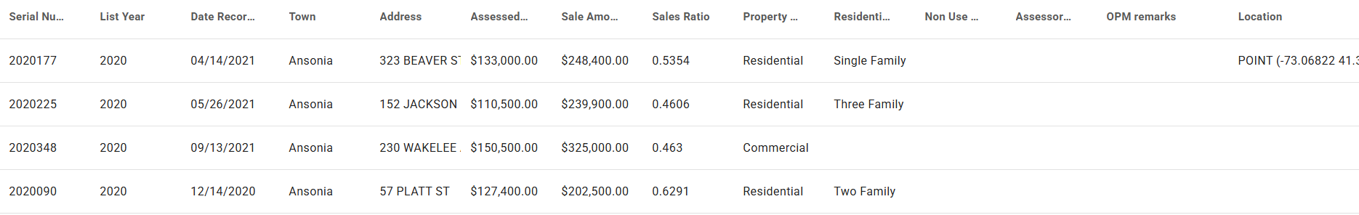
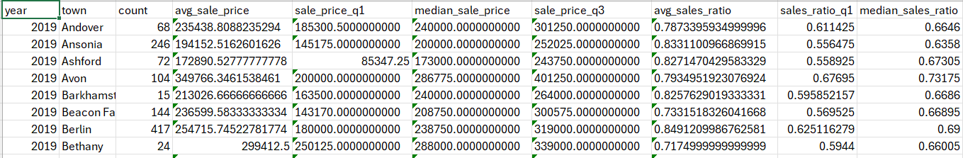
Data Pre-Processing: Visualization
Before
After

Slide 6
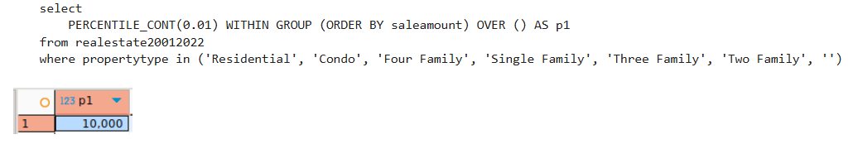
Missing Values
There were many records with some bad data. For example,
~380,000 with blank property type
~2,000 with $0 sale price
We used “reasonable” guidelines to remove outliers. For example, using the 1st percentile price as a cutoff.

Slide 7
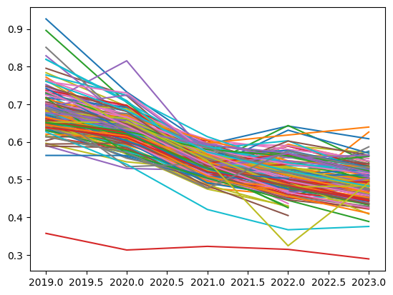
Exploratory Analysis: Sales Ratio
We visualized the median sales ratio for municipalities from 2019
There is a clear downward trend. Sales ratio = assessed value / sale price, indicating that prices are outpacing assessments.

Slide 8
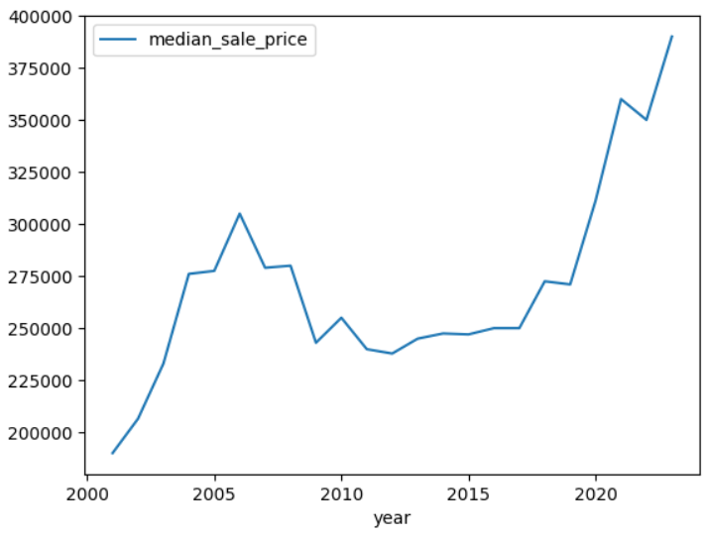
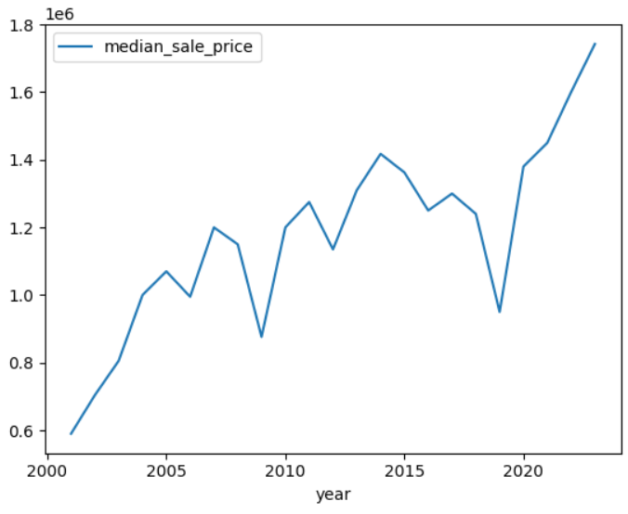
Exploratory Analysis: Price Trends
When graphing sale price over time, we found major differences between municipalities.
Milford
Darien

Slide 9
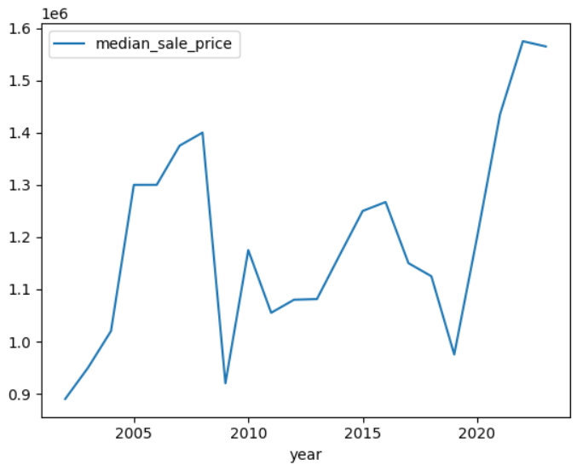
Exploratory Analysis: Price Trends
Wealthy Fairfield County towns had more similar price trends with a correlation coefficient between year and sale price of 0.7 compared with 0.17 for all towns.
Darien
New Canaan

Slide 10
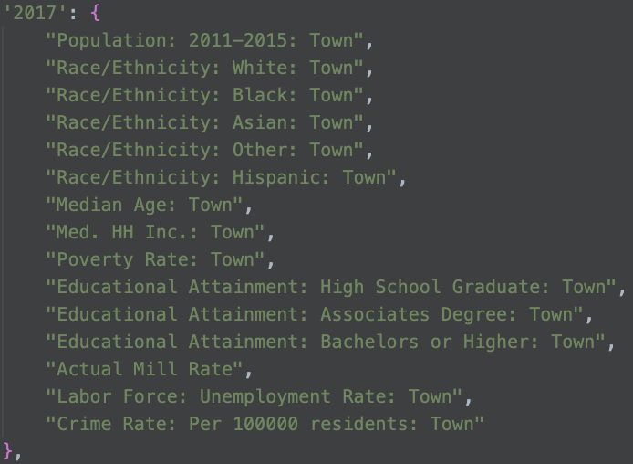
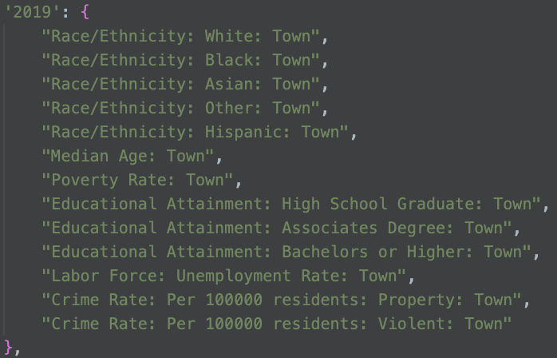
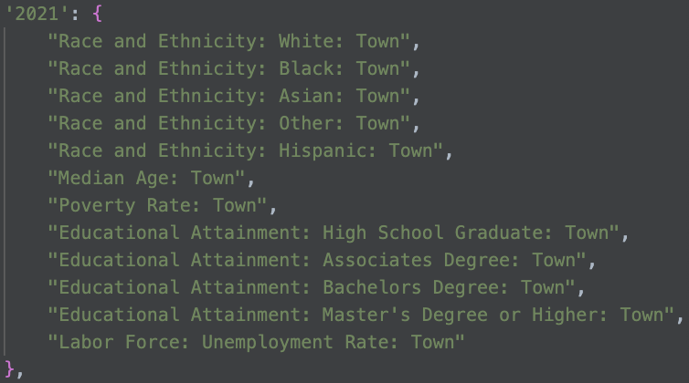
Unstructured data extraction
The PDFs containing municipality statistics differed in structure from year to year
Manually choose fields from PDFs that were similar across different PDFs
Later needed to write code to combine similar fields

Slide 11
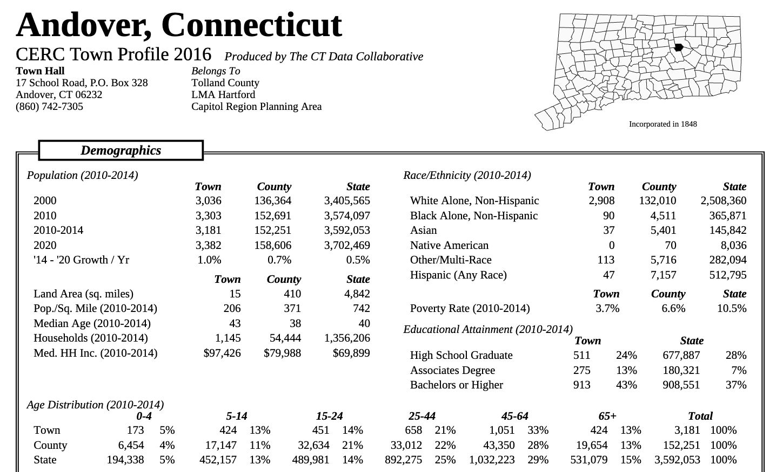

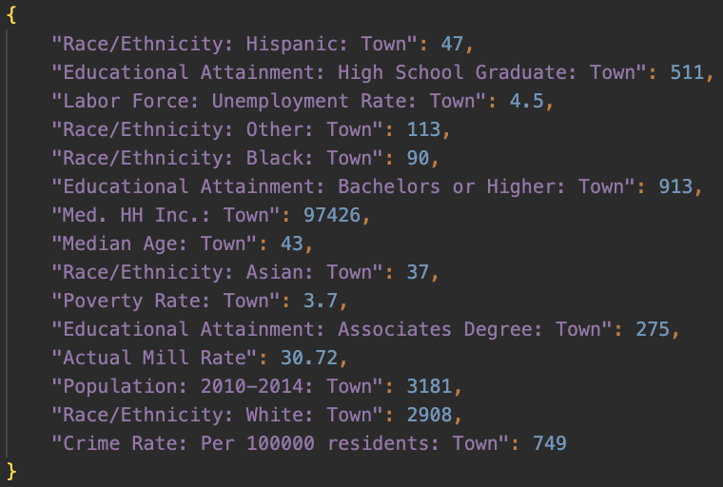

LLM-based data extraction
Scraped unstructured PDF data using Open AI’s API
Extracted data was put into JSON format, as the data could be represented in key value pairs

Slide 12
LLM-based data extraction
Specific prompts were used to get requested data
LLM sometimes hallucinated, returning invalid data
Some returned data was able to be further “cleaned” with code. If it couldn’t, PDF scraping script needed to be rerun
"You are an expert extraction algorithm. Only extract relevant information from the pdf. If you do not know the value of an attribute asked to extract, return null for the attribute's value. Attributes: {attributes[year]}. Return JSON markdown only, I just need JSON markdown. Do not reply with anything else"

Slide 13



LLM-based data extraction
Processed 1,015 pdf’s with 2 pages each
Took <60 mins for LLM to scrape data from all PDF’s
Cost ~$16
…

Slide 14

Merging & Cleaning Unstructured Data
Using code to merge and clean data was the best option. LLM frequently returned incorrect results
Five duplicate columns related to Race/Ethnicity got dropped and merged
Some years had empty data

Slide 15
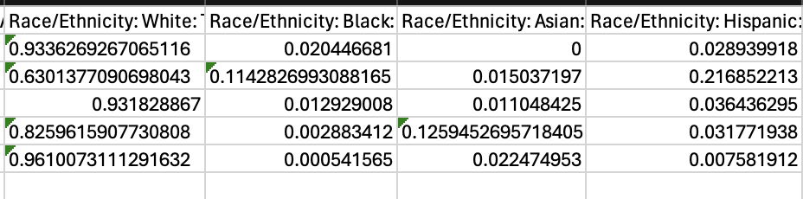
Normalizing Unstructured Data
There were entries with number of people and others with percentage of population
Columns were normalize so that they would be in percent format
Educational Attainment and Race/Ethnicity columns were normalized

Slide 16


Structured with Unstructured Data
Code (python script) was used to combine the structured data with the unstructured data
JSON was turned into CSV format and combined
Similar to previously mentioned points, LLM returned incorrect results

Slide 17
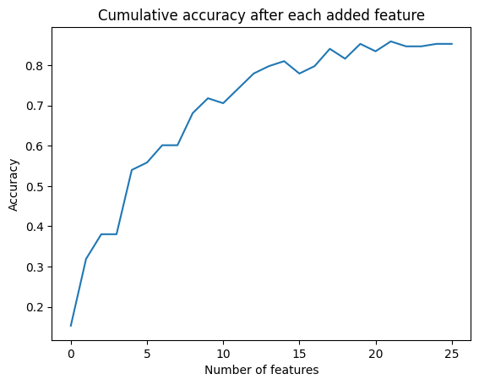
Supervised Analysis: Random Forest
Random Forest Classification:
Using municipal features, can we predict the county? Are there certain combinations of features that are unique to a geographical region?
We iterated through all features, and measured the increase in accuracy after adding that feature.
We kept the most “important” features that raised the cumulative accuracy

Slide 18
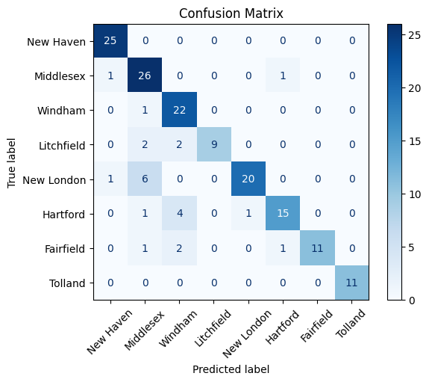

Supervised Analysis: Random Forest
Some of the most important features were:
Sale Count
Average Sale Price
Sales Ratio Q1
Total net grand list
Mill rate: motor vehicle
Net current education expenditures
We tuned # of estimators by choosing the one with greatest accuracy.

Slide 19
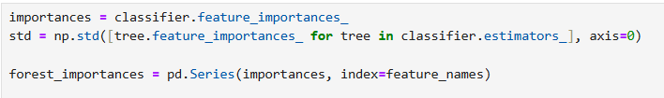
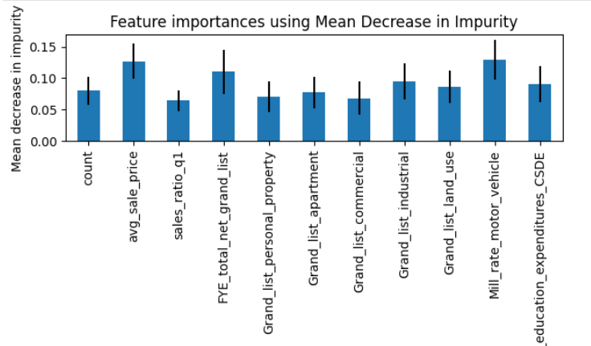
Generate Explanations: Random Forest
We use scikit learn methods to measure feature importance.

Slide 20
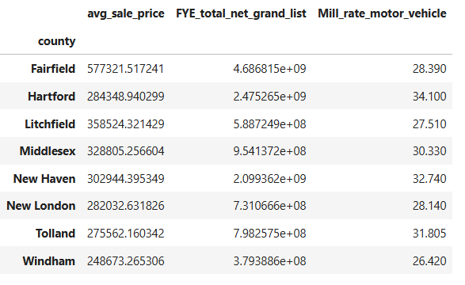
Generate Explanations: County Characteristics
We took the three most “important” features and computed the median, grouped by county.
Fairfield has high sale price
Windham has the lowest values across all three features.
Litchfield County has the second highest sale price for residential homes, but a relatively low grand list -> few apartments/other large properties?

Slide 21
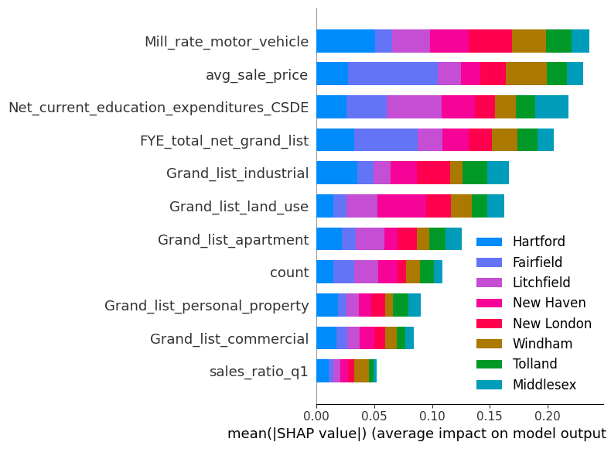
Generate Explanations: SHAP
The SHAP summary plot visualizes the importance of each feature in predicting different counties
Consistent with scikit learn methods, we see that motor vehicle mill rate is very important for classifying Hartford County and sale price for Fairfield County

Slide 22
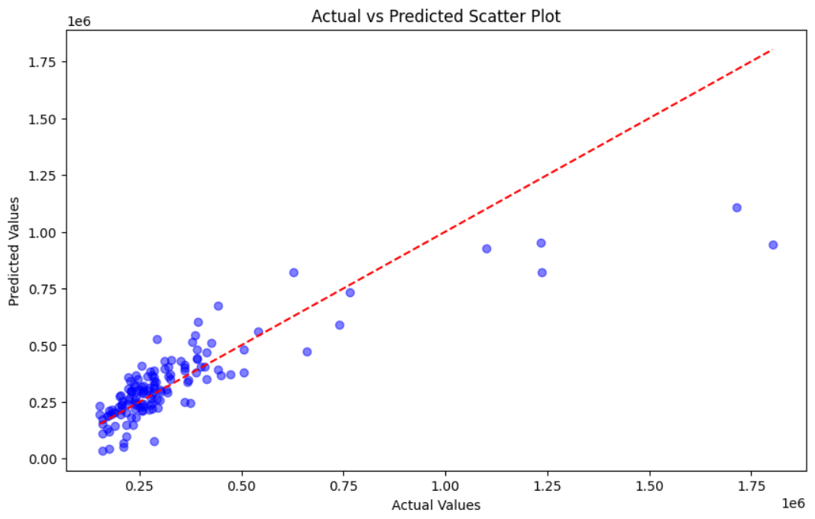
Supervised Analysis: OLS
Sale price vs. per-capita income: how closely related are they?
We plotted the actual sale prices with predicted sale prices

Slide 23

Supervised Analysis: OLS
Analyzing the effect of outliers:
The RMSE of the regression model was $128,888, which is pretty high
After taking out the most expensive, outlier municipalities, the RMSE decreased to $71,304.

Slide 24
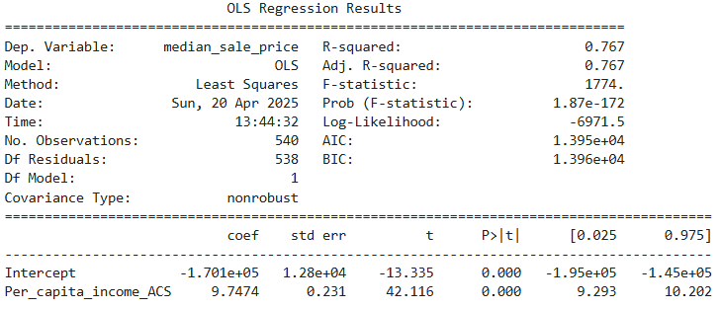
Feature Importance: OLS
R-squared is 0.767, indicating a strong relationship
P > |t| is 0, indicating the probability that the coefficient is measured through our model by chance, is 0

Slide 25
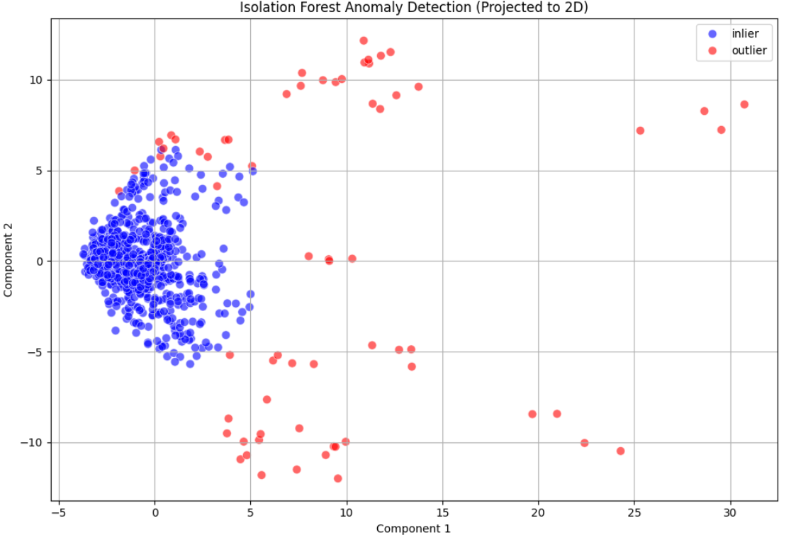
Unsupervised Analysis - Anomaly Detection
We use Isolation Forest to find “rare” municipalities.
To visualize the model, we use PCA to reduce down to 2 features.

Slide 26
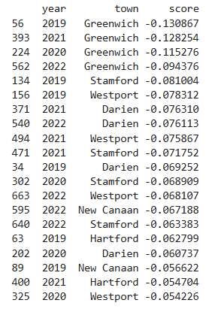
Examining Anomalies
Towns like Greenwich, Westport, etc. are very wealthy and expensive, so are unsurprising. We look at the more “surprising” anomalies:
Stamford has a standardized vacant land grand list of +9 to +11 consistently, meaning its total vacant land value is very high.
Hartford’s property mill rate is +5 and vehicle mill rate is +2, but sales ratio is -3

Slide 27
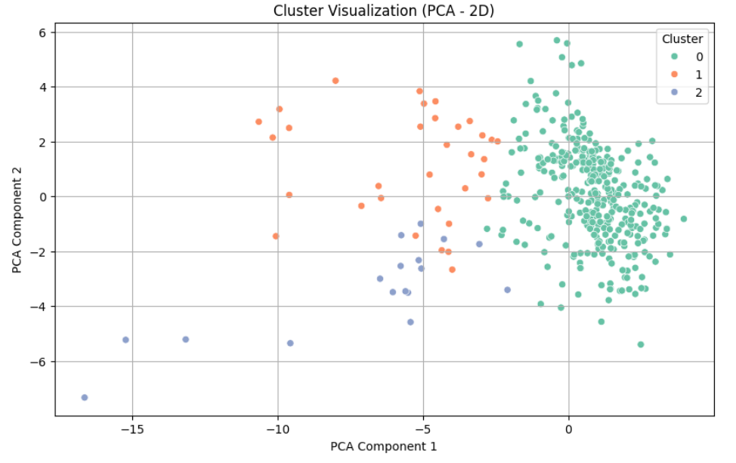
Unsupervised Analysis: K-means
We clustered municipalities using K-Means, specifically focusing on the unstructured data like educational attainment and crime rate

Slide 28
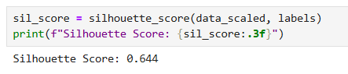
Unsupervised Analysis - K-Means
We used silhouette score to measure our clustering quality
Silhouette score was is 0.64, which indicates reasonable and strong clustering
Notes:
Silhouette score ranges from -1 to 1
A score over 0.7 is considered "strong". A score over 0.5 is considered "reasonable". A score over 0.25 is considered "weak".
Choose 3 clusters because it gave the best Silhouette score
Data points were well-matched to their assigned clusters and poorly matched to neighboring clusters

Slide 29
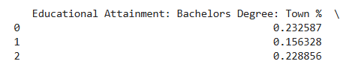
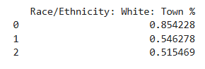
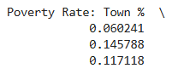
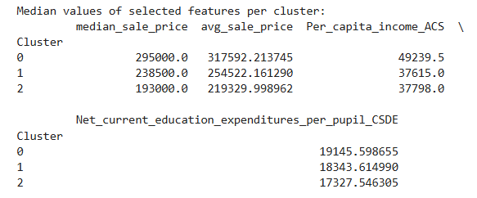
K-Means: Exploring the Clusters
Cluster 0 has high educational attainment and lower diversity
Cluster 1 has lower educational attainment, higher poverty, and higher diversity
Cluster 2 is moderate, in between 1 and 2.
We computed feature medians across clusters:
Cluster 0 has higher income and sale price
Educational spending isn’t as strongly related to home prices as expected.

Slide 30
Thank you! Questions?

